Slide 1
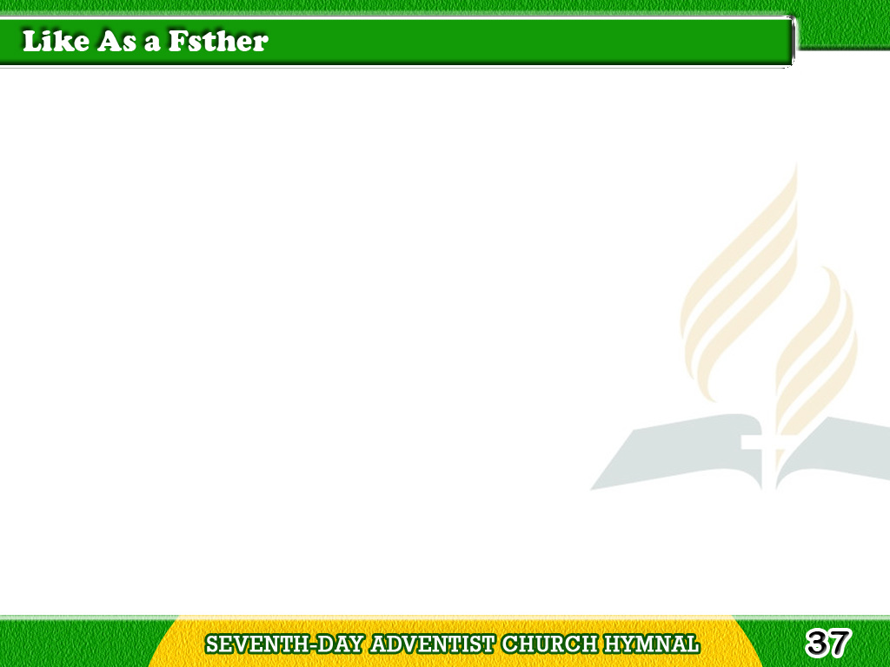
1/4
Like as a father
pities his child,
So the Lord pities
the sinner defiled;
Tagalog
Version

Slide 2
1/4
Waiteth in kindness,
Pities our blindness,
Longeth to welcome,
though of ten reviled.
Tagalog
Version

Slide 3
2/4
Like as a father
when we believe,
Merciful still,
He will gladly receive;
Tagalog
Version

Slide 4
2/4
Listens to hear us,
Blesses to cheer us,
Pities when ever
His Spirit we grieve.
Tagalog
Version

Slide 5
3/4
Like as a father,
ever the same,
He hath created,
and knoweth our frame;
Tagalog
Version

Slide 6
3/4
Watcheth the straying,
Guardeth the praying,
Bids us to trust in His
Spirit almighty name.
Tagalog
Version

Slide 7
4/4
Like as a father,
constant is He,
God in compassion
regardeth our plea;
Tagalog
Version

Slide 8
4/4
In need He cometh,
Precious His promise:
Father in heaven
forever to be.
Tagalog
Version

